Slide 1
Hugros Inc.
Fume, Dust, Spillage, Process Material and Waste
Collection and Recycling Systems
www.hugros.com

Slide 2
Hugros is a technology solution provider for industries for all their requirements to keep a safer and green work environment. We bring the world’s best technology and solutions to provide it to our valuable customers. For this we have tied up with the best companies around the globe to bring their quality products in India.
Our Profile

Slide 3
Environmental Solutions
Our Divisions
Spillage, Process Material Collection and Recycling
Dust and Fume Extraction Systems
Automation and MetrologySolutions
Automation Systems for Engineering and Automobile Industries
Online SPC based Electronic and Air gauges
Solid Waste Processing and Recycling Solutions
We provide all types of solid waste processing solutions for industries, and municipalities.

Slide 4
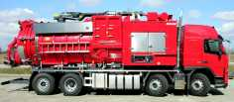
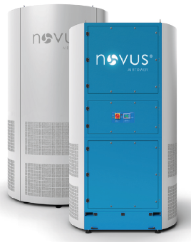
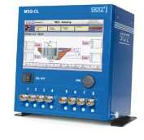
Our Partners
, Sweden – For High Vac Systems, Centralized Vacuum Systems, Truck/Trailer Mounted Vacuum Systems
& - For Air Tower Extraction Systems and portable dust and Welding Fume extraction systems
- Online SPC based Air and Electronic Gauges

Slide 5
Our Products for Environmental Solutions
Centralized Vacuum Systems
Truck / Trailer Mounted Vacuum Systems
High Vacuum Road Sweeper
Bulk Material Transfer Systems
Vac Loaders
Portable and Centralized Dust Extraction Systems
Portable and Centralized Fume Extraction Systems
Oil Mist Separators
Tower Extraction Systems

Slide 6
Our Products for Automation & Metrology
Automation Systems for Machining and Measurement
Air and electronic Gauges
Online SPC based Measuring systems

Slide 7
Our Products for Solid Waste Recycling
Organic Waste Composting Machines
24hrs Composting Machines
BIOCHEST Series natural Composting Machines
In - Vessel Rotary Drum Composting Machines
ENERGYBIN Portable Biogas Plants
PET bottle Flaking Machines

Slide 8
Organic Waste Composting
Composting is a biological process that is optimized when the starting carbon to nitrogen ratio is in the range of 30:1 and the moisture and oxygen levels and temperatures are closely managed and monitored. When processing household organics, it is of critical importance to have the right starting mix of feedstocks, and to manage moisture, oxygen and temperatures closely in order to minimize the risk of nuisance factors and
environmental impacts. The composting process takes around 4-8 weeks time to get a natural mature compost. This process can be catalyzed by automation to reduce the composting time. Proper aeration is adequate to maintain the proper process and eliminate the formation of leachate and anaerobic conditions to avoid bad odor coming out. Agitation is done for proper mixing of waste with the bacteria to work on. The composting machines are distinguished by their methods implemented to achieve the good quality compost output.

Slide 9
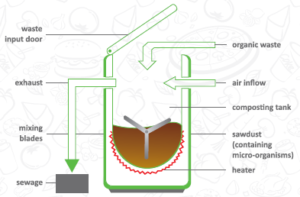
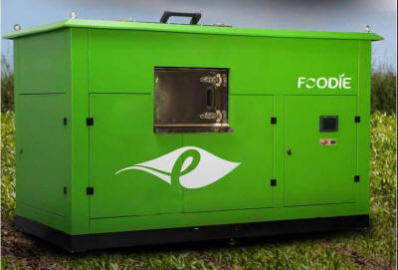
24 Hrs - Organic Waste Composting Machines
As the name implies it reduces the waste volume by 80-90% using within 24hrs time using an in built heating system and the composting of the dry waste will take 10 days after which the compost can be collected on a daily basis. This model is best suited for compact space requirements and a faster processing of the daily waste is required. There is no need of adding bacteria culture since a part of the compost containing the useful bacteria is kept inside the machine.

Slide 10
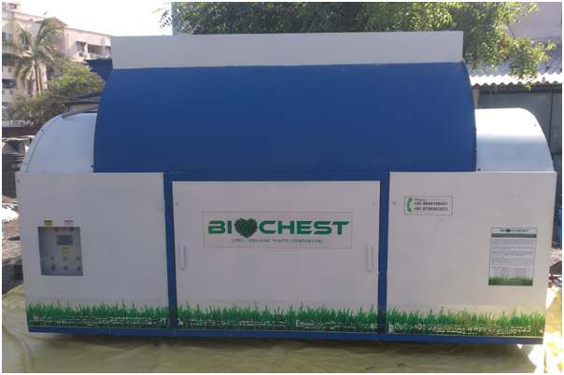
Biochest - Organic Waste Composting Machines
Biochest series is designed to boost the natural way of composting by providing adequate air and mechanized mixing of the waste with the active bacteria. Air is required in composting process to avoid the anaerobic conditions which will result in leachate production. The composting process takes 21 days which is the maximum among all the methods available in composting ensuring a good quality compost which further can be cured for maximum one week for commercial usage.
Pros :
70% less power consumption compared with heater based systems
Good quality natural compost as output
Less curing time required
Cons :
Bigger sized machines compared with heater based models
Bacteria culture addition along with waste

Slide 11
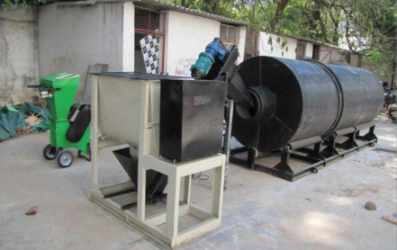
In-Vessel Rotary Drum Composting Machines
As the name implies the composting process happens inside a drum which will rotate enabling the bacteria to have homogenous mixing with the waste. The fresh waste is added from one end and works out with the bacteria for 10-14 days time while moving to the other end and exits automatically. Further curing can be done for one week if desired. To make the process faster an inbuilt shredder is fitted before to make the waste into small and even sized.
Pros :
The power consumption is the least and is only 3-4 units per day
Good quality natural compost as output
Less curing time required
Cons :
Bigger sized machines compared with heater based models
Bacteria culture addition along with waste

Slide 12
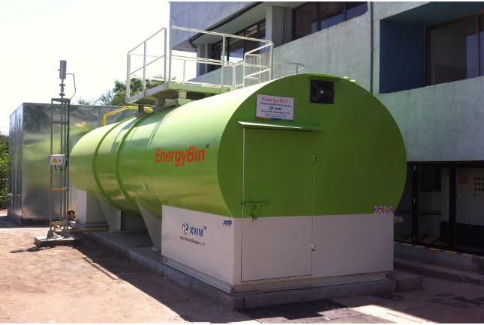
ENERGY BIN Portable Biogas Plants
EnergyBin is a portable biogas plant which is highly efficient, time saving and most advanced. It has been certified and recognized major institutions including IIT Madras. These plants are best suitable for organizations where the biogas can be utilized either for cooking or in the form of electricity converted using a biogas compatible electricity generator. The liquid manure can be directly used for gardening or farming processes. The return of investment is merely 14 months which is far better compared with the organic composting methods for processing the waste.
Pros :
Highly efficient and less space required.
Less Maintenance cost compared with the conventional biogas setups
Cons :
Water is required
Liquid manure which ahs to be used for farming or treated.

Slide 13
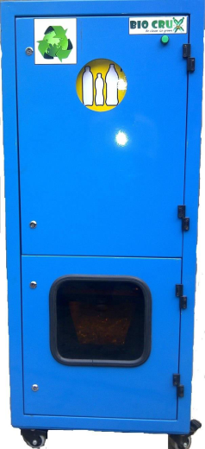
PET BOTTLE Flaking Machines
PET bottles have become an unavoidable part of human life coming with packaged drinking water and soft drinks we consume daily. But as the usage increases the recycling and handling of these waste becomes a headache. Our PET bottle flaking machines are user friendly and can be installed anywhere where there is bulk dumping of these bottles are there or compacting is required. These machines can convert the PET bottles into flakes which can be directly transferred to the recycling industries or where the flakes are primary material of manufacturing other by products.
• 8,64,000 pet bottle can be crushed annually
• 85% Volume reduction
• 17.2 tones of waste gets recycled per year
• 1,000 liters of crude oil saved per year on recycling
• 10 times reduction in transportation hence saving in fuel & CO2 emission
• 13 cubic yard of landfill freed per year
• 43.2 metric tons of Carbon dioxides emissions reduced
• ISO certification/Audit for waste management

Slide 14
Industries Served
Engineering and Automobile
Food and Pharma
Steel Industries
Power Plants
Cement Industries
Foundries
Chemical Industries
Bulk Minerals and Material Industries and
Paper and Pulp Industries

Slide 15
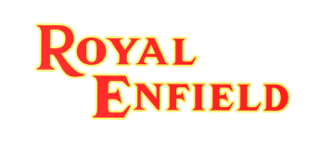
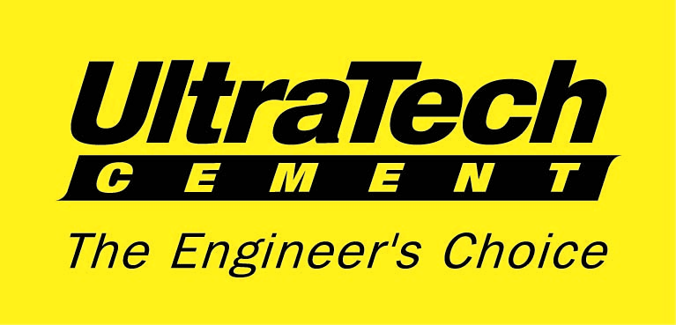
Our Major Customers

Slide 16
Hugros Inc.
Thank You
www.hugros.com

